Slide 1
Association rule mining
Eung–Hee Kim
ehkim@sunmoon.ac.kr
2019.04.22

Slide 2














Association rules
collect
purchasing
pattern analysis
point-of-sale system
rule generation
sales
strategy
→
keyword
application
→
keyword
suggestion
item
recommendation
product
arrangement
frequently purchased items together

Slide 3
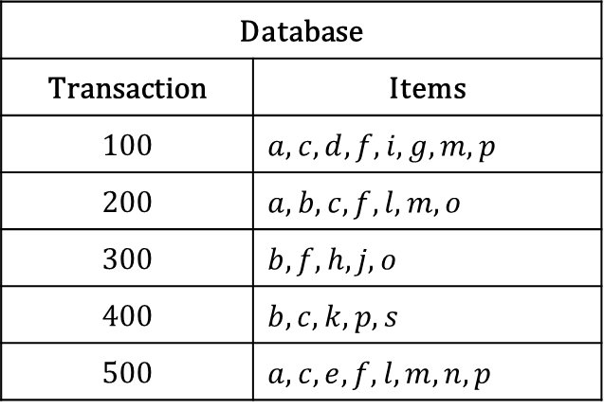
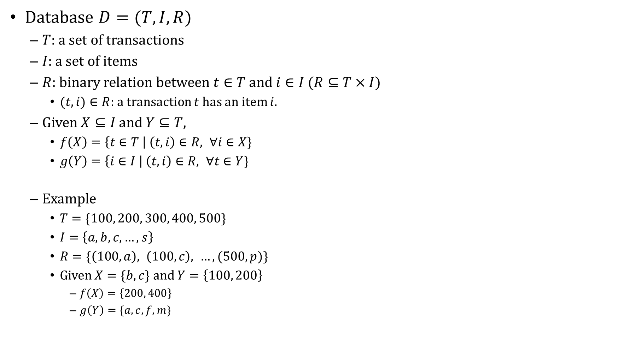
Database and basic operators
Database $D=(T, I, R)$
$T$: a set of transactions
$I$: a set of items
$R$: binary relation between $t∈T$ and $i∈I$ $(R⊆T×I)$
$(t, i)∈R$: a transaction $t$ has an item $i$.
Given $X⊆I$ and $Y⊆T$,
$f\left(X\right)=\left\{t∈T \right| \left(t, i\right)∈R, ∀i∈X\}$
$g\left(Y\right)=\left\{i∈I \right| \left(t, i\right)∈R, ∀t∈Y\}$
Example
$T=\{100, 200, 300, 400, 500\}$
$I=\left\{a, b, c, …, s\right\}$
$R=\{\left(100, a\right), \left(100, c\right), …, (500, p)\}$
Given $X=\{b, c\}$ and $Y=\left\{100, 200\right\}$
$f\left(X\right)=\left\{200, 400\right\}$
$g\left(Y\right)=\{a, c, f, m\}$
Database
Transaction | Items
100 | $a, c, d, f, i, g, m, p$
200 | $a, b, c, f, l, m, o$
300 | $b, f, h, j, o$
400 | $b, c, k, p, s$
500 | $a, c, e, f, l, m, n, p$
Example of a database

Slide 4
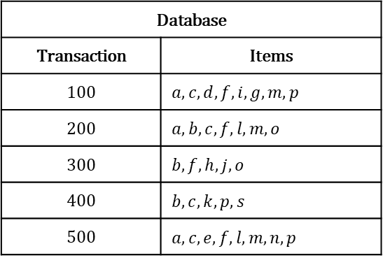

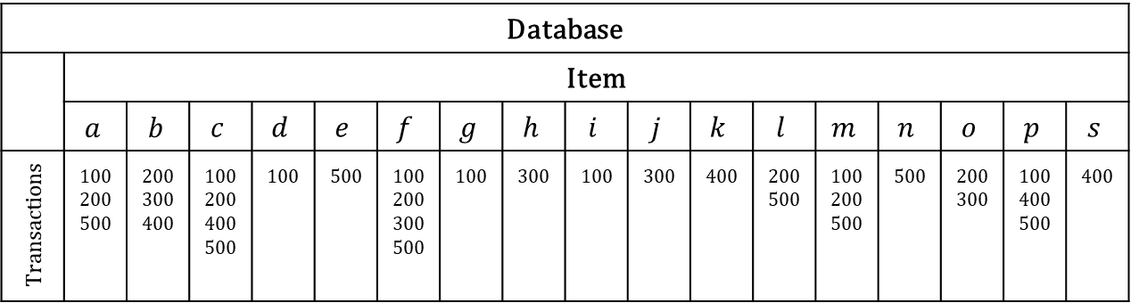

Horizontal and vertical data format
Database
Transaction | Items
100 | $a, c, d, f, i, g, m, p$
200 | $a, b, c, f, l, m, o$
300 | $b, f, h, j, o$
400 | $b, c, k, p, s$
500 | $a, c, e, f, l, m, n, p$
Database
 | Item
 | $$a$$ | $$b$$ | $$c$$ | $$d$$ | $$e$$ | $$f$$ | $$g$$ | $$h$$ | $$i$$ | $$j$$ | $$k$$ | $$l$$ | $$m$$ | $$n$$ | $$o$$ | $$p$$ | $$s$$
Transactions | ₁₀₀ ₂₀₀ ₅₀₀ | ₂₀₀ ₃₀₀ ₄₀₀ | ₁₀₀ ₂₀₀ ₄₀₀ ₅₀₀ | ₁₀₀ | ₅₀₀ | ₁₀₀ ₂₀₀ ₃₀₀ ₅₀₀ | ₁₀₀ | ₃₀₀ | ₁₀₀ | ₃₀₀ | ₄₀₀ | ₂₀₀ ₅₀₀ | ₁₀₀ ₂₀₀ ₅₀₀ | ₅₀₀ | ₂₀₀ ₃₀₀ | ₁₀₀ ₄₀₀ ₅₀₀ | ₄₀₀
Horizontal data format
Vertical data format
Number of visits: $X=\{b, c\}$ and $Y=\{100, 200\}$
$$f(X)$$
$$g(Y)$$

Slide 5
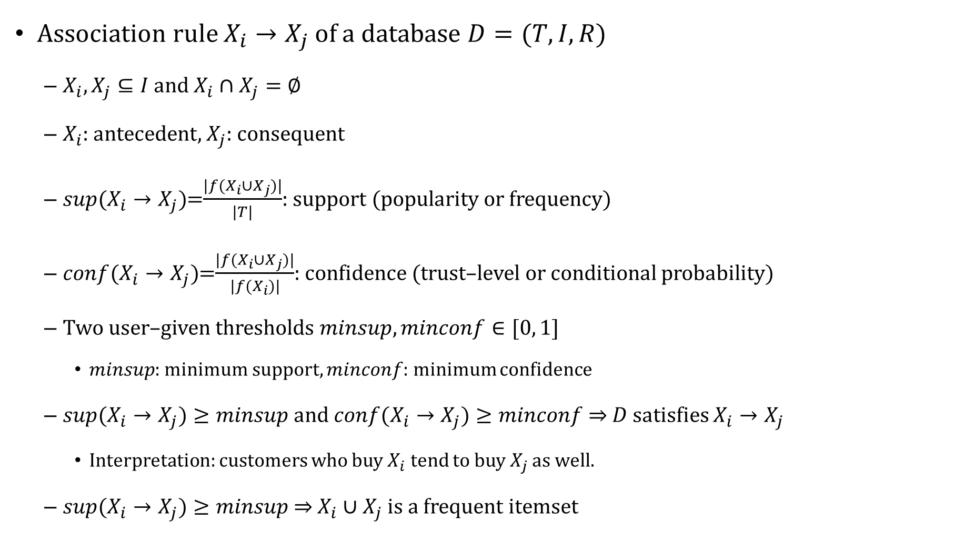
Association rule
Association rule $X_{i}→X_{j}$ of a database $D=(T, I, R)$
$X_{i}, X_{j}⊆I$ and $X_{i}∩X_{j}=∅$
$X_{i}$: antecedent, $X_{j}$: consequent
$sup⁡(X_{i}→X_{j})$=$\frac{|f(X_{i}∪X_{j})|}{|T|}$: support (popularity or frequency)
$conf⁡(X_{i}→X_{j})$=$\frac{|f(X_{i}∪X_{j})|}{|f(X_{i})|}$: confidence (trust–level or conditional probability)
Two user–given thresholds $minsup, minconf∈[0, 1]$
$minsup$: minimum support, $minconf$: minimum confidence
$sup⁡(X_{i}→X_{j})≥minsup$ and $conf⁡(X_{i}→X_{j})≥minconf$ $⇒$ $D$ satisfies $X_{i}→X_{j}$
Interpretation: customers who buy $X_{i}$ tend to buy $X_{j}$ as well.
$sup⁡(X_{i}→X_{j})≥minsup$ $⇒$ $X_{i}∪X_{j}$ is a frequent itemset

Slide 6
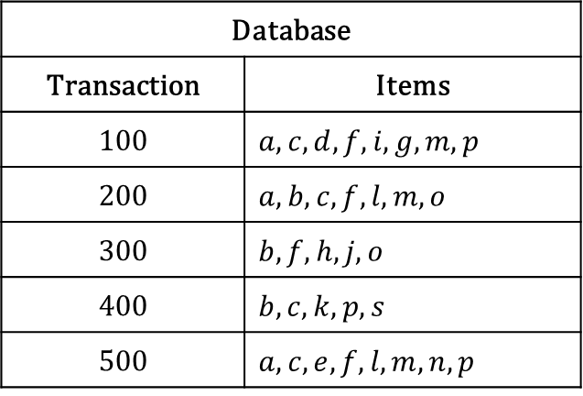

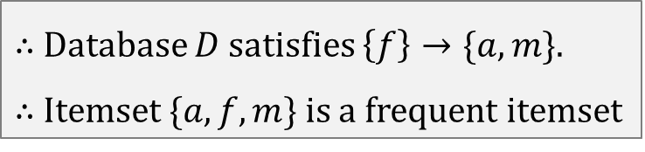
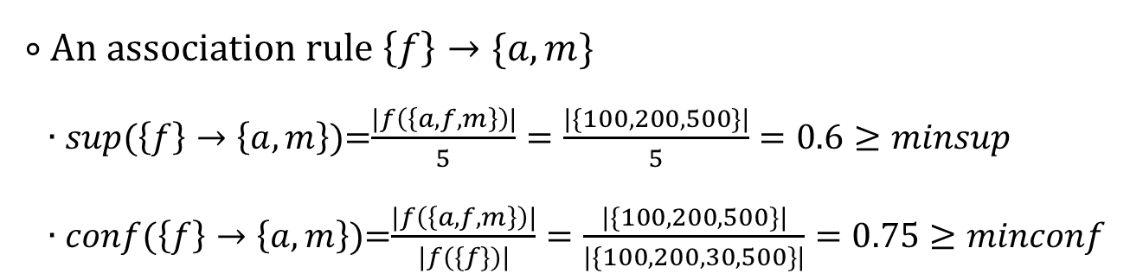
Association rule
Example with $minsup=0.5$ and $minconf=0.6$
Database
Transaction | Items
100 | $a, c, d, f, i, g, m, p$
200 | $a, b, c, f, l, m, o$
300 | $b, f, h, j, o$
400 | $b, c, k, p, s$
500 | $a, c, e, f, l, m, n, p$
∘ An association rule $\left\{f\right\}→\{a, m\}$
∙ $sup⁡(\left\{f\right\}→\left\{a, m\right\})$=$\frac{|f\left(\left\{a, f, m\right\}\right)|}{5}=\frac{|\{100, 200, 500\}|}{5}=0.6≥minsup$
∙ $conf⁡(\left\{f\right\}→\left\{a, m\right\})$=$\frac{|f\left(\left\{a, f, m\right\}\right)|}{|f(\{f\})|}=\frac{|\{100, 200, 500\}|}{|\{100, 200, 30,500\}|}=0.75≥minconf$
$∴$ Database $D$ satisfies $\left\{f\right\}→\{a, m\}$.
$∴$ Itemset $\{a, f, m\}$ is a frequent itemset
Example of a database

Slide 7


Mining association rules
$$minsup$$
$$minconf$$
Database
Frequent itemset
Association rule

Slide 8
Mining association rules
Major challenge: mining frequent itemsets
$$minsup$$
$$minconf$$
Database
Frequent itemset
Association rule

Slide 9

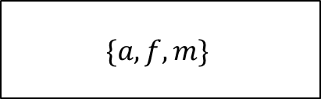
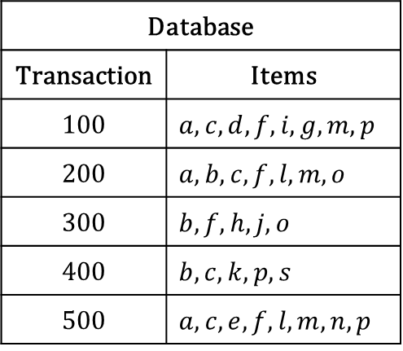
Mining association rules
Major challenge: mining frequent itemsets
$$minsup$$
$$minconf$$
Database
Frequent itemset
Association rule
Database
Transaction | Items
100 | $a, c, d, f, i, g, m, p$
200 | $a, b, c, f, l, m, o$
300 | $b, f, h, j, o$
400 | $b, c, k, p, s$
500 | $a, c, e, f, l, m, n, p$
$$0.5$$
$$\{a, f, m\}$$
Example of a database

Slide 10

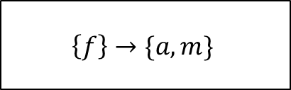
Mining association rules
Major challenge: mining frequent itemsets
$$minsup$$
$$minconf$$
Database
Frequent itemset
Association rule
Database
Transaction | Items
100 | $a, c, d, f, i, g, m, p$
200 | $a, b, c, f, l, m, o$
300 | $b, f, h, j, o$
400 | $b, c, k, p, s$
500 | $a, c, e, f, l, m, n, p$
$$0.5$$
$$0.6$$
$$\{a, f, m\}$$
$$\left\{f\right\}→\{a, m\}$$
Example of a database

Slide 11
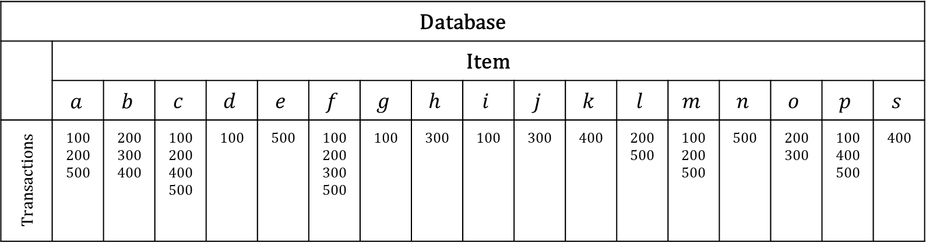

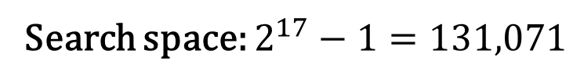
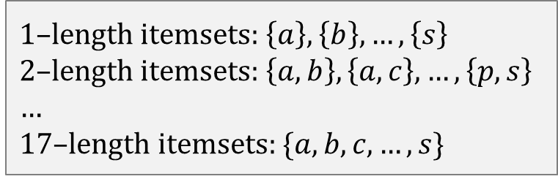
Mining frequent patterns
Naïve approach: check $2^{n}−1$ itemsets ($n$: the number of items) with $minsup∈[0, 1]$
Database
 | Item
 | $$a$$ | $$b$$ | $$c$$ | $$d$$ | $$e$$ | $$f$$ | $$g$$ | $$h$$ | $$i$$ | $$j$$ | $$k$$ | $$l$$ | $$m$$ | $$n$$ | $$o$$ | $$p$$ | $$s$$
Transactions | ₁₀₀ ₂₀₀ ₅₀₀ | ₂₀₀ ₃₀₀ ₄₀₀ | ₁₀₀ ₂₀₀ ₄₀₀ ₅₀₀ | ₁₀₀ | ₅₀₀ | ₁₀₀ ₂₀₀ ₃₀₀ ₅₀₀ | ₁₀₀ | ₃₀₀ | ₁₀₀ | ₃₀₀ | ₄₀₀ | ₂₀₀ ₅₀₀ | ₁₀₀ ₂₀₀ ₅₀₀ | ₅₀₀ | ₂₀₀ ₃₀₀ | ₁₀₀ ₄₀₀ ₅₀₀ | ₄₀₀
Example of a database
1–length itemsets: $\left\{a\right\},\left\{b\right\}, …,\left\{s\right\}$
2–length itemsets: $\left\{a, b\right\},\left\{a, c\right\}, …,\left\{p, s\right\}$
…
17–length itemsets: $\{a, b, c, …, s\}$
Search space: $2^{17}−1=131,071$

Slide 12
1. Fast algorithm for mining association rules: Apriori algorithm

Slide 13

Apriori algorithm
Reducing the search space based on the following idea:
Let $Xk$ is not a frequent itemset with length $k$
Let $X_{k+1}$ is an itemset with length $k+1$ such that $X_{k}⊂X_{k+1}$
In this case, $X_{k+1}$ can’t be a frequent itemset.

Slide 14

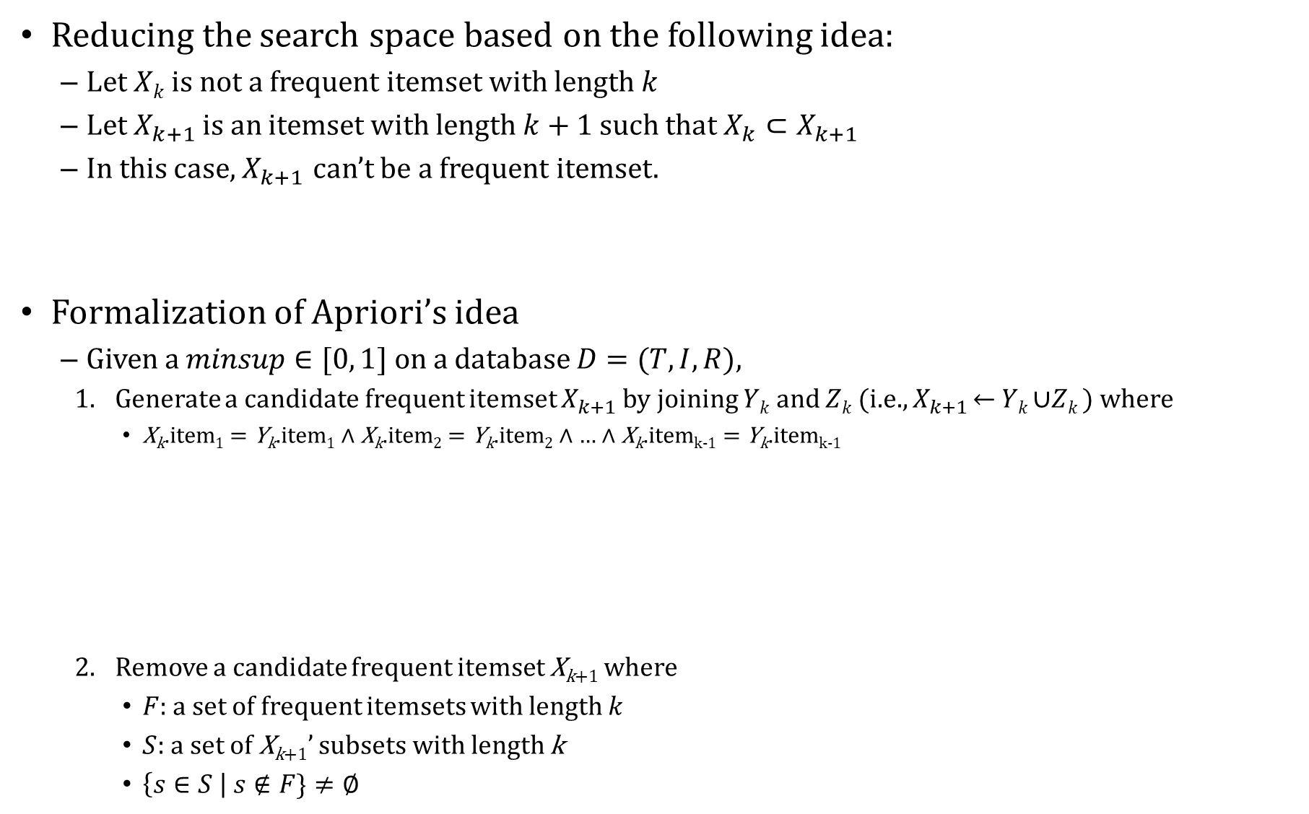



Apriori algorithm
Reducing the search space based on the following idea:
Let $Xk$ is not a frequent itemset with length $k$
Let $X_{k+1}$ is an itemset with length $k+1$ such that $X_{k}⊂X_{k+1}$
In this case, $X_{k+1}$ can’t be a frequent itemset.
Formalization of Apriori’s idea
Given a $minsup∈[0, 1]$ on a database $D=(T, I, R)$,
Generate a candidate frequent itemset $X_{k+1}$ by joining $Yk$ and $Zk$ (i.e., $X_{k+1}$ ← $Yk$ ∪$Zk$) where
X_{k}.item₁ = Y_{k}.item₁ ∧ X_{k}.item₂ = Y_{k}.item₂ ∧ … ∧ X_{k}.item_{k-1} = Y_{k}.item_{k-1}
Remove a candidate frequent itemset X_{k+1} where
$F$: a set of frequent itemsets with length $k$
$S$: a set of X_{k+1}’ subsets with length k
$\left\{s∈S \right| s∉F\}≠∅$
$$Y_{k}$$
$$X_{k+1}$$
$$Z_{k}$$
+
$X_{k+1}$ is not a frequent itemset

Slide 15

Working example of Apriori
Database
 | Item
 | a | b | c | d | e | f | g | h | i | j | k | l | m | n | o | p | s
Transactions | ₁₀₀ ₂₀₀ ₅₀₀ | ₂₀₀ ₃₀₀ ₄₀₀ | ₁₀₀ ₂₀₀ ₄₀₀ ₅₀₀ | ₁₀₀ | ₅₀₀ | ₁₀₀ ₂₀₀ ₃₀₀ ₅₀₀ | ₁₀₀ | ₃₀₀ | ₁₀₀ | ₃₀₀ | ₄₀₀ | ₂₀₀ ₅₀₀ | ₁₀₀ ₂₀₀ ₅₀₀ | ₅₀₀ | ₂₀₀ ₃₀₀ | ₁₀₀ ₄₀₀ ₅₀₀ | ₄₀₀
minsup
0.5 (≥3)
Sample database
1–length frequent itemset
{a}
{b}
{c}
{f}
{m}
{p}
2–length candidate itemset
{a, b} | {b, m}
{a, c} | {b, p}
{a, f} | {c, f}
{a, m} | {c, m}
{a, p} | {c, p}
{b, c} | {f, m}
{b, f} | {f, p}
2–length candidate itemset
{a, b} | {b, m}
{a, c} | {b, p}
{a, f} | {c, f}
{a, m} | {c, m}
{a, p} | {c, p}
{b, c} | {f, m}
{b, f} | {f, p}
Candidate generation
Filter out with subset (skipped)
Filter out with $minsup$

Slide 16

Working example of Apriori (cont.)
Database
 | Item
 | a | b | c | d | e | f | g | h | i | j | k | l | m | n | o | p | s
Transactions | ₁₀₀ ₂₀₀ ₅₀₀ | ₂₀₀ ₃₀₀ ₄₀₀ | ₁₀₀ ₂₀₀ ₄₀₀ ₅₀₀ | ₁₀₀ | ₅₀₀ | ₁₀₀ ₂₀₀ ₃₀₀ ₅₀₀ | ₁₀₀ | ₃₀₀ | ₁₀₀ | ₃₀₀ | ₄₀₀ | ₂₀₀ ₅₀₀ | ₁₀₀ ₂₀₀ ₅₀₀ | ₅₀₀ | ₂₀₀ ₃₀₀ | ₁₀₀ ₄₀₀ ₅₀₀ | ₄₀₀
Sample database
2–length frequent itemset
{a, c}
{a, f}
{a, m}
{c, f}
{c, m}
{c, p}
{f, m}
3–length candidate itemset
{a, c, f}
{a, c, m}
{a, f, m}
{c, f, m}
{c, f, p}
{c, m, p}
3–length candidate itemset
{a, c, f}
{a, c, m}
{a, f, m}
{c, f, m}
{c, f, p}
{c, m, p}
3–length frequent itemset
{a, c, f}
{a, c, m}
{a, f, m}
{c, f, m}
Candidate generation
Filter out with subset
Filter out with $minsup$

Slide 17
Working example of Apriori (cont.)
Database
 | Item
 | a | b | c | d | e | f | g | h | i | j | k | l | m | n | o | p | s
Transactions | ₁₀₀ ₂₀₀ ₅₀₀ | ₂₀₀ ₃₀₀ ₄₀₀ | ₁₀₀ ₂₀₀ ₄₀₀ ₅₀₀ | ₁₀₀ | ₅₀₀ | ₁₀₀ ₂₀₀ ₃₀₀ ₅₀₀ | ₁₀₀ | ₃₀₀ | ₁₀₀ | ₃₀₀ | ₄₀₀ | ₂₀₀ ₅₀₀ | ₁₀₀ ₂₀₀ ₅₀₀ | ₅₀₀ | ₂₀₀ ₃₀₀ | ₁₀₀ ₅₀₀ | ₄₀₀
Sample database
minsup
3–length frequent itemset
{a, c, f}
{a, c, m}
{a, f, m}
{c, f, m}
0.5 (≥3)
4–length candidate itemset
{a, c, f, m}
4–length frequent itemset
{a, c, f, m}
Filter out with subset
Candidate generation
Filter out with minsup

Slide 18
Working example of Apriori (cont.)
Database
 | Item
 | a | b | c | d | e | f | g | h | i | j | k | l | m | n | o | p | s
Transactions | ₁₀₀ ₂₀₀ ₅₀₀ | ₂₀₀ ₃₀₀ ₄₀₀ | ₁₀₀ ₂₀₀ ₄₀₀ ₅₀₀ | ₁₀₀ | ₅₀₀ | ₁₀₀ ₂₀₀ ₃₀₀ ₅₀₀ | ₁₀₀ | ₃₀₀ | ₁₀₀ | ₃₀₀ | ₄₀₀ | ₂₀₀ ₅₀₀ | ₁₀₀ ₂₀₀ ₅₀₀ | ₅₀₀ | ₂₀₀ ₃₀₀ | ₁₀₀ ₅₀₀ | ₄₀₀
minsup
0.5 (≥3)
Sample database
1–length frequent itemset
{a}
{b}
{c}
{f}
{m}
{p}
2–length frequent itemset
{a, c}
{a, f}
{a, m}
{c, f}
{c, m}
{c, p}
{f, m}
3–length frequent itemset
{a, c, f}
{a, c, m}
{a, f, m}
{c, f, m}
4–length frequent itemset
{a, c, f, m}

Slide 19

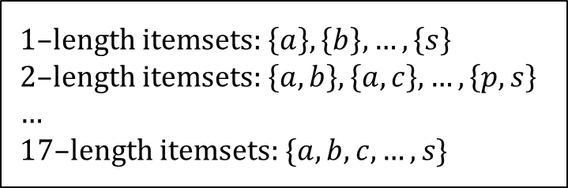
Naïve approach vs. Apriori
Database
 | Item
 | a | b | c | d | e | f | g | h | i | j | k | l | m | n | o | p | s
Transactions | ₁₀₀ ₂₀₀ ₅₀₀ | ₂₀₀ ₃₀₀ ₄₀₀ | ₁₀₀ ₂₀₀ ₄₀₀ ₅₀₀ | ₁₀₀ | ₅₀₀ | ₁₀₀ ₂₀₀ ₃₀₀ ₅₀₀ | ₁₀₀ | ₃₀₀ | ₁₀₀ | ₃₀₀ | ₄₀₀ | ₂₀₀ ₅₀₀ | ₁₀₀ ₂₀₀ ₅₀₀ | ₅₀₀ | ₂₀₀ ₃₀₀ | ₁₀₀ ₅₀₀ | ₄₀₀
minsup
0.5 (≥3)
Sample database
Naïve approach
Apriori
1–length itemsets: $\left\{a\right\},\left\{b\right\}, …,\left\{s\right\}$
2–length itemsets: $\left\{a, b\right\},\left\{a, c\right\}, …,\left\{p, s\right\}$
…
17–length itemsets: $\{a, b, c, …, s\}$
Search space (1/3,449)
17 (1–length candidates) + 14 (2–length candidates) +
6 (3–length candidates) +1 (4–length candidates) = 38
Search space: $2^{17}−1=131,071$

Slide 20
2. Mining frequent patterns without candidate generation: FP–growth algorithm

Slide 21
FP–growth algorithm: based on horizontal data formatted–database
Starting from the drawbacks of Apriori
Too many candidates
Too many accesses to the database
Too naïve data structure (i.e., vertical data format)
Core idea
Without candidate generation
Only 2 accesses to the database
A compact structure, called FP–tree (Frequent pattern–tree)
Robust for database update (addition of transactions)

Slide 22
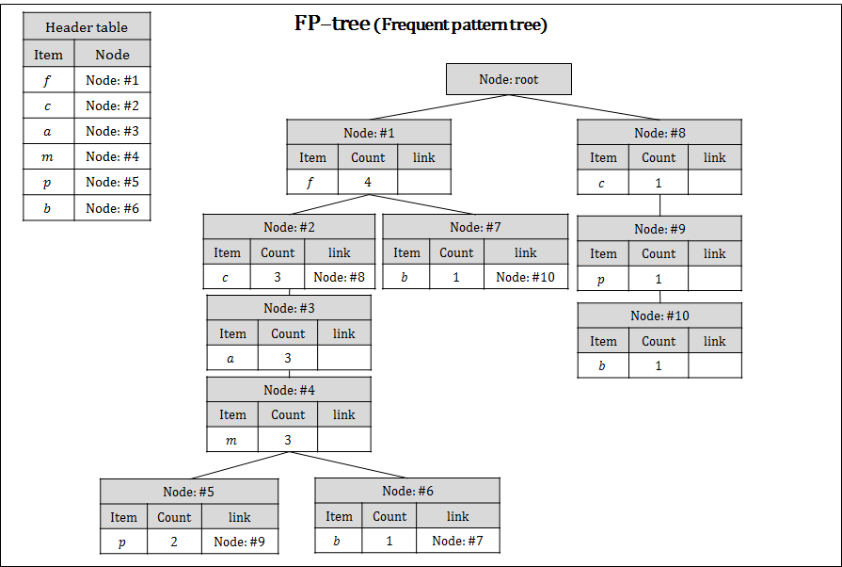
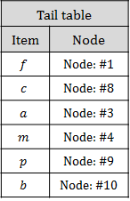
FP–tree
FP–tree := (1) header table + (2) tail table + (3) tree
Database
Transaction | Items
100 | a, c, d, f, i, g, m, p
200 | a, b, c, f, l, m, o
300 | b, f, h, j, o
400 | b, c, k, p, s
500 | a, c, e, f, l, m, n, p
Horizontal data format

Slide 23
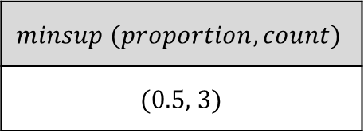
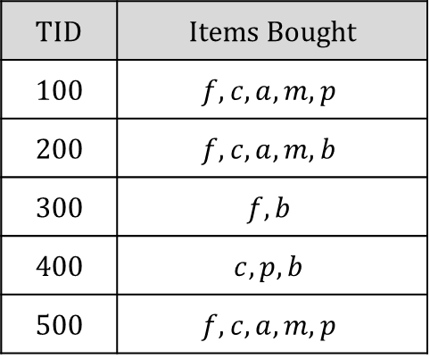
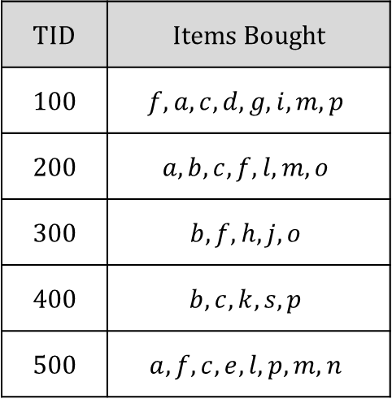
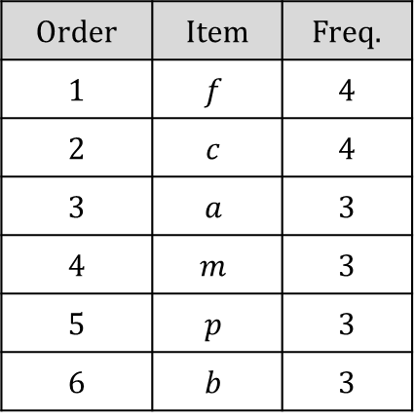
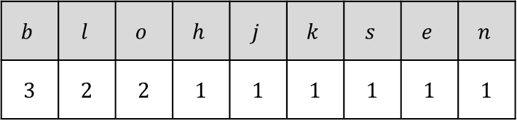
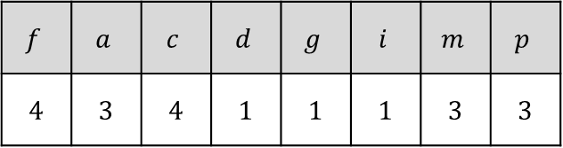
Working example
DB scanning
TID | Items Bought
100 | $$f, a, c, d, g, i, m, p$$
200 | $$a, b, c, f, l, m, o$$
300 | $$b, f, h, j, o$$
400 | $$b, c, k, s, p$$
500 | $$a, f, c, e, l, p, m, n$$
Determining the frequency of each item
Threshold
$$f$$ | $$a$$ | $$c$$ | $$d$$ | $$g$$ | $$i$$ | $$m$$ | $$p$$
4 | 3 | 4 | 1 | 1 | 1 | 3 | 3
$$minsup (proportion, count)$$
(0.5, 3)
$$b$$ | $$l$$ | $$o$$ | $$h$$ | $$j$$ | $$k$$ | $$s$$ | $$e$$ | $$n$$
3 | 2 | 2 | 1 | 1 | 1 | 1 | 1 | 1
Deleting & sorting items of transactions
according to the item order
Taking frequent ones only and
sorting them in a descending order
DB scanning
TID | Items Bought
100 | $$f, c, a, m, p$$
200 | $$f, c, a, m, b$$
300 | $$f, b$$
400 | $$c, p, b$$
500 | $$f, c, a, m, p$$
Order | Item | Freq.
1 | $$f$$ | 4
2 | $$c$$ | 4
3 | $$a$$ | 3
4 | $$m$$ | 3
5 | $$p$$ | 3
6 | $$b$$ | 3

Slide 24

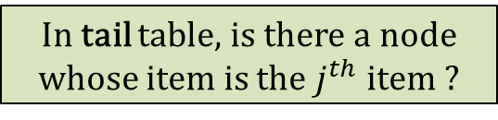

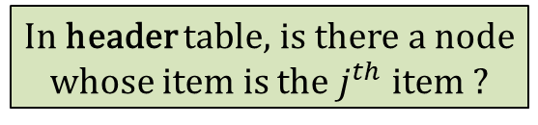
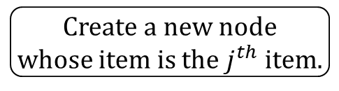
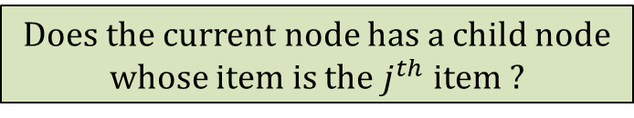
Workflow to build a FP–tree
For each $i^{th}$ transaction
Set current node as the root node
For each $j^{th}$ item
Does the current node has a child node
whose item is the $j^{th}$ item ?
YES
NO
Increase the count
of the child node.
Create a new node
whose item is the $j^{th}$ item.
Set current node as
the child node.
Set the count of
the new node as 1.
Set the parent–child rel.
between current and new.
Set current node as
the new node.
In header table, is there a node
whose item is the $j^{th}$ item ?
YES
In tail table, is there a node
whose item is the $j^{th}$ item ?
NO
YES
NO
Add the new node to
header table.
Set the next link of the
existing node as the new node.
Add the new node to
tail table.
Replace the existing node to
the new node in tail table.

Slide 25
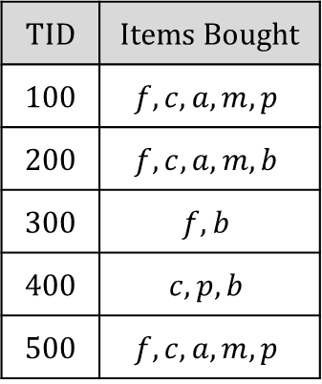
Working example
FP–tree (Frequent pattern tree)
Header table
Item | Node
Tail table
Item | Node
TID | Items Bought
100 | $$f, c, a, m, p$$
200 | $$f, c, a, m, b$$
300 | $$f, b$$
400 | $$c, p, b$$
500 | $$f, c, a, m, p$$
Current node

Slide 26
Working example
FP–tree (Frequent pattern tree)
Header table
Item | Node
Node: root
Tail table
Item | Node
TID | Items Bought
100 | $$f, c, a, m, p$$
200 | $$f, c, a, m, b$$
300 | $$f, b$$
400 | $$c, p, b$$
500 | $$f, c, a, m, p$$
Current node
Node: root

Slide 27

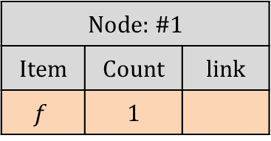

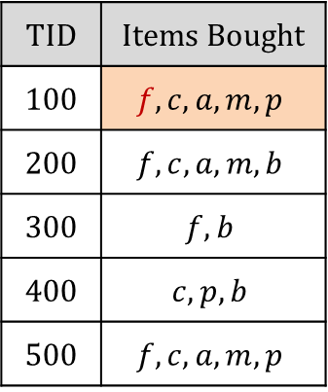
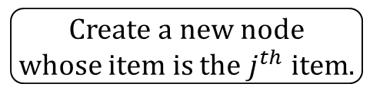
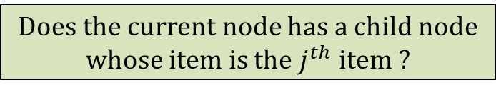
Working example
For each $i^{th}$ transaction
Set current node as the root node
For each $j^{th}$ item
Does the current node has a child node
whose item is the $j^{th}$ item ?
NO
FP–tree (Frequent pattern tree)
Create a new node
whose item is the $j^{th}$ item.
Header table
Item | Node
Node: root
Set the count of
the new node as 1.
Node: #1
Item | Count | link
$$f$$ | 1
Set the parent–child rel.
between current and new.
Set current node as
the new node.
Tail table
Item | Node
TID | Items Bought
100 | $$f, c, a, m, p$$
200 | $$f, c, a, m, b$$
300 | $$f, b$$
400 | $$c, p, b$$
500 | $$f, c, a, m, p$$
Current node
Node: root → #1

Slide 28
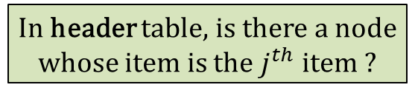
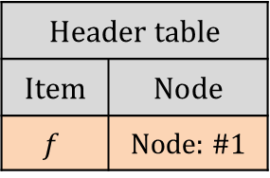
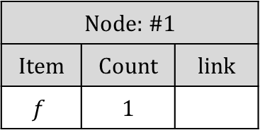
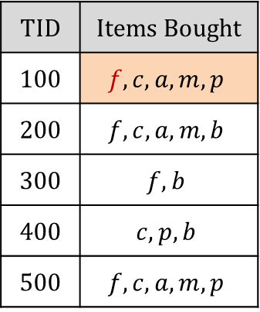
Working example
For each $i^{th}$ transaction
Set current node as the root node
For each $j^{th}$ item
…
FP–tree (Frequent pattern tree)
In header table, is there a node
whose item is the $j^{th}$ item ?
Header table
Item | Node
$$f$$ | Node: #1
NO
Node: root
Add the new node to
header table.
Node: #1
Item | Count | link
$$f$$ | 1
Tail table
Item | Node
TID | Items Bought
100 | $$f, c, a, m, p$$
200 | $$f, c, a, m, b$$
300 | $$f, b$$
400 | $$c, p, b$$
500 | $$f, c, a, m, p$$
Current node
Node: #1

Slide 29
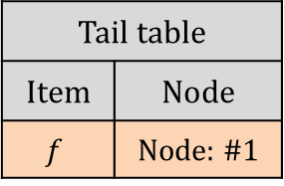
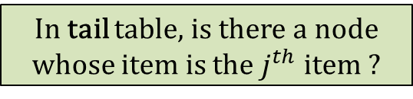
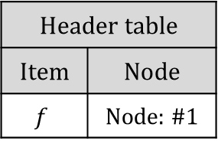
Working example
For each $i^{th}$ transaction
Set current node as the root node
For each $j^{th}$ item
…
FP–tree (Frequent pattern tree)
In tail table, is there a node
whose item is the $j^{th}$ item ?
Header table
Item | Node
$$f$$ | Node: #1
NO
Node: root
Add the new node to
tail table.
Node: #1
Item | Count | link
$$f$$ | 1
Tail table
Item | Node
$$f$$ | Node: #1
TID | Items Bought
100 | $$f, c, a, m, p$$
200 | $$f, c, a, m, b$$
300 | $$f, b$$
400 | $$c, p, b$$
500 | $$f, c, a, m, p$$
Current node
Node: #1

Slide 30
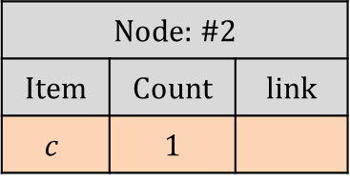

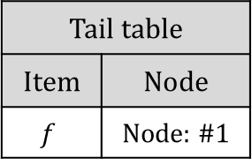
Working example
For each $i^{th}$ transaction
Set current node as the root node
For each $j^{th}$ item
Does the current node has a child node
whose item is the $j^{th}$ item ?
FP–tree (Frequent pattern tree)
NO
Create a new node
whose item is the $j^{th}$ item.
Header table
Item | Node
$$f$$ | Node: #1
Node: root
Set the count of
the new node as 1.
Node: #1
Item | Count | link
$$f$$ | 1
Set the parent–child rel.
between current and new.
Set current node as
the new node.
Tail table
Item | Node
$$f$$ | Node: #1
Node: #2
Item | Count | link
$$c$$ | 1
TID | Items Bought
100 | $$f, c, a, m, p$$
200 | $$f, c, a, m, b$$
300 | $$f, b$$
400 | $$c, p, b$$
500 | $$f, c, a, m, p$$
Current node
Node: #1 → #2

Slide 31
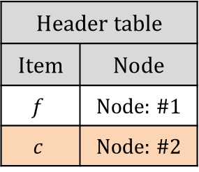


Working example
For each $i^{th}$ transaction
Set current node as the root node
For each $j^{th}$ item
…
FP–tree (Frequent pattern tree)
In header table, is there a node
whose item is the $j^{th}$ item ?
Header table
Item | Node
$$f$$ | Node: #1
$$c$$ | Node: #2
NO
Node: root
Add the new node to
header table.
Node: #1
Item | Count | link
$$f$$ | 1
Tail table
Item | Node
$$f$$ | Node: #1
Node: #2
Item | Count | link
$$c$$ | 1
TID | Items Bought
100 | $$f, c, a, m, p$$
200 | $$f, c, a, m, b$$
300 | $$f, b$$
400 | $$c, p, b$$
500 | $$f, c, a, m, p$$
Current node
Node: #2

Slide 32
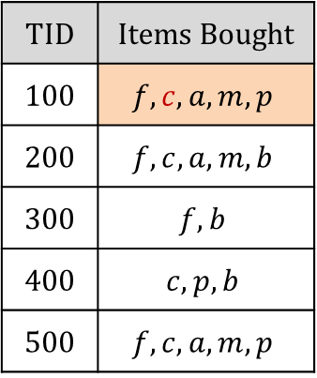
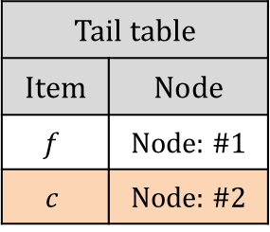
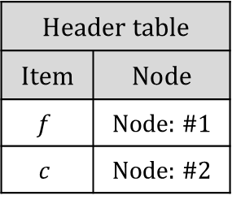
Working example
For each $i^{th}$ transaction
Set current node as the root node
For each $j^{th}$ item
…
FP–tree (Frequent pattern tree)
In tail table, is there a node
whose item is the $j^{th}$ item ?
Header table
Item | Node
$$f$$ | Node: #1
$$c$$ | Node: #2
NO
Node: root
Add the new node to
tail table.
Node: #1
Item | Count | link
$$f$$ | 1
Tail table
Item | Node
$$f$$ | Node: #1
$$c$$ | Node: #2
Node: #2
Item | Count | link
$$c$$ | 1
TID | Items Bought
100 | $$f, c, a, m, p$$
200 | $$f, c, a, m, b$$
300 | $$f, b$$
400 | $$c, p, b$$
500 | $$f, c, a, m, p$$
Current node
Node: #2

Slide 33
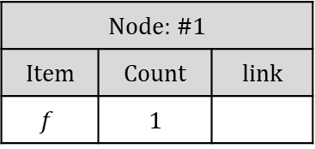







Working example
FP–tree (Frequent pattern tree)
Header table
Item | Node
$$f$$ | Node: #1
$$c$$ | Node: #2
$$a$$ | Node: #3
$$m$$ | Node: #4
$$p$$ | Node: #5
Node: root
TID | Items Bought
100 | $$f, c, a, m, p$$
200 | $$f, c, a, m, b$$
300 | $$f, b$$
400 | $$c, p, b$$
500 | $$f, c, a, m, p$$
Node: #1
Item | Count | link
$$f$$ | 1
Node: #2
Item | Count | link
$$c$$ | 1
Tail table
Item | Node
$$f$$ | Node: #1
$$c$$ | Node: #2
$$a$$ | Node: #3
$$m$$ | Node: #4
$$p$$ | Node: #5
Node: #3
Item | Count | link
$$a$$ | 1
Node: #4
Item | Count | link
$$m$$ | 1
Node: #5
Item | Count | link
$$p$$ | 1
Current node
#2 →#3 →#4 → #5

Slide 34








Working example
For each $i^{th}$ transaction
Set current node as the root node
For each $j^{th}$ item
Does the current node has a child node
whose item is the $j^{th}$ item ?
FP–tree (Frequent pattern tree)
YES
Increase the count
of the child node.
Header table
Item | Node
$$f$$ | Node: #1
$$c$$ | Node: #2
$$a$$ | Node: #3
$$m$$ | Node: #4
$$p$$ | Node: #5
Node: root
Set current node as
the child node.
Node: #1
Item | Count | link
$$f$$ | 2
Node: #2
Item | Count | link
$$c$$ | 1
Tail table
Item | Node
$$f$$ | Node: #1
$$c$$ | Node: #2
$$a$$ | Node: #3
$$m$$ | Node: #4
$$p$$ | Node: #5
TID | Items Bought
100 | $$f, c, a, m, p$$
200 | $$f, c, a, m, b$$
300 | $$f, b$$
400 | $$c, p, b$$
500 | $$f, c, a, m, p$$
Node: #3
Item | Count | link
$$a$$ | 1
Node: #4
Item | Count | link
$$m$$ | 1
Current node
Node: root → #1
Node: #5
Item | Count | link
$$p$$ | 1

Slide 35





Working example
For each $i^{th}$ transaction
Set current node as the root node
For each $j^{th}$ item
Does the current node has a child node
whose item is the $j^{th}$ item ?
FP–tree (Frequent pattern tree)
YES
Increase the count
of the child node.
Header table
Item | Node
$$f$$ | Node: #1
$$c$$ | Node: #2
$$a$$ | Node: #3
$$m$$ | Node: #4
$$p$$ | Node: #5
Node: root
Set current node as
the child node.
Node: #1
Item | Count | link
$$f$$ | 2
Node: #2
Item | Count | link
$$c$$ | 2
Tail table
Item | Node
$$f$$ | Node: #1
$$c$$ | Node: #2
$$a$$ | Node: #3
$$m$$ | Node: #4
$$p$$ | Node: #5
TID | Items Bought
100 | $$f, c, a, m, p$$
200 | $$f, c, a, m, b$$
300 | $$f, b$$
400 | $$c, p, b$$
500 | $$f, c, a, m, p$$
Node: #3
Item | Count | link
$$a$$ | 2
Node: #4
Item | Count | link
$$m$$ | 2
Current node
Node: #1→#2→#3→#4
Node: #5
Item | Count | link
$$p$$ | 1

Slide 36








Working example
For each $i^{th}$ transaction
Set current node as the root node
For each $j^{th}$ item
Does the current node has a child node
whose item is the $j^{th}$ item ?
FP–tree (Frequent pattern tree)
NO
Create a new node
whose item is the $j^{th}$ item.
Header table
Item | Node
$$f$$ | Node: #1
$$c$$ | Node: #2
$$a$$ | Node: #3
$$m$$ | Node: #4
$$p$$ | Node: #5
Node: root
Set the count of
the new node as 1.
Node: #1
Item | Count | link
$$f$$ | 2
Set the parent–child rel.
between current and new.
Node: #2
Item | Count | link
$$c$$ | 2
Set current node as
the new node.
Tail table
Item | Node
$$f$$ | Node: #1
$$c$$ | Node: #2
$$a$$ | Node: #3
$$m$$ | Node: #4
$$p$$ | Node: #5
Node: #3
Item | Count | link
$$a$$ | 2
TID | Items Bought
100 | $$f, c, a, m, p$$
200 | $$f, c, a, m, b$$
300 | $$f, b$$
400 | $$c, p, b$$
500 | $$f, c, a, m, p$$
Node: #4
Item | Count | link
$$m$$ | 2
Current node
Node: #4→#6
Node: #5
Item | Count | link
$$p$$ | 1
Node: #6
Item | Count | link
$$b$$ | 1

Slide 37




Working example
For each $i^{th}$ transaction
Set current node as the root node
For each $j^{th}$ item
…
FP–tree (Frequent pattern tree)
In header table, is there a node
whose item is the $j^{th}$ item ?
Header table
Item | Node
$$f$$ | Node: #1
$$c$$ | Node: #2
$$a$$ | Node: #3
$$m$$ | Node: #4
$$p$$ | Node: #5
$$b$$ | Node: #6
Node: root
NO
Add the new node to
header table.
Node: #1
Item | Count | link
$$f$$ | 2
Node: #2
Item | Count | link
$$c$$ | 2
Tail table
Item | Node
$$f$$ | Node: #1
$$c$$ | Node: #2
$$a$$ | Node: #3
$$m$$ | Node: #4
$$p$$ | Node: #5
Node: #3
Item | Count | link
$$a$$ | 2
TID | Items Bought
100 | $$f, c, a, m, p$$
200 | $$f, c, a, m, b$$
300 | $$f, b$$
400 | $$c, p, b$$
500 | $$f, c, a, m, p$$
Node: #4
Item | Count | link
$$m$$ | 2
Current node
Node: #6
Node: #5
Item | Count | link
$$p$$ | 1
Node: #6
Item | Count | link
$$b$$ | 1

Slide 38



Working example
For each $i^{th}$ transaction
Set current node as the root node
For each $j^{th}$ item
…
FP–tree (Frequent pattern tree)
In tail table, is there a node
whose item is the $j^{th}$ item ?
Header table
Item | Node
$$f$$ | Node: #1
$$c$$ | Node: #2
$$a$$ | Node: #3
$$m$$ | Node: #4
$$p$$ | Node: #5
$$b$$ | Node: #6
Node: root
NO
Add the new node to
tail table.
Node: #1
Item | Count | link
$$f$$ | 2
Node: #2
Item | Count | link
$$c$$ | 2
Tail table
Item | Node
$$f$$ | Node: #1
$$c$$ | Node: #2
$$a$$ | Node: #3
$$m$$ | Node: #4
$$p$$ | Node: #5
$$b$$ | Node: #6
Node: #3
Item | Count | link
$$a$$ | 2
TID | Items Bought
100 | $$f, c, a, m, p$$
200 | $$f, c, a, m, b$$
300 | $$f, b$$
400 | $$c, p, b$$
500 | $$f, c, a, m, p$$
Node: #4
Item | Count | link
$$m$$ | 2
Current node
Node: #6
Node: #5
Item | Count | link
$$p$$ | 1
Node: #6
Item | Count | link
$$b$$ | 1

Slide 39



Working example
For each $i^{th}$ transaction
Set current node as the root node
For each $j^{th}$ item
Does the current node has a child node
whose item is the $j^{th}$ item ?
FP–tree (Frequent pattern tree)
YES
Header table
Item | Node
$$f$$ | Node: #1
$$c$$ | Node: #2
$$a$$ | Node: #3
$$m$$ | Node: #4
$$p$$ | Node: #5
$$b$$ | Node: #6
Increase the count
of the child node.
Node: root
Set current node as
the child node.
Node: #1
Item | Count | link
$$f$$ | 3
Node: #2
Item | Count | link
$$c$$ | 2
Tail table
Item | Node
$$f$$ | Node: #1
$$c$$ | Node: #2
$$a$$ | Node: #3
$$m$$ | Node: #4
$$p$$ | Node: #5
$$b$$ | Node: #6
Node: #3
Item | Count | link
$$a$$ | 2
TID | Items Bought
100 | $$f, c, a, m, p$$
200 | $$f, c, a, m, b$$
300 | $$f, b$$
400 | $$c, p, b$$
500 | $$f, c, a, m, p$$
Node: #4
Item | Count | link
$$m$$ | 2
Current node
Node: root→#1
Node: #5
Item | Count | link
$$p$$ | 1
Node: #6
Item | Count | link
$$b$$ | 1

Slide 40














Working example
For each $i^{th}$ transaction
Set current node as the root node
For each $j^{th}$ item
Does the current node has a child node
whose item is the $j^{th}$ item ?
FP–tree (Frequent pattern tree)
NO
Header table
Item | Node
$$f$$ | Node: #1
$$c$$ | Node: #2
$$a$$ | Node: #3
$$m$$ | Node: #4
$$p$$ | Node: #5
$$b$$ | Node: #6
Create a new node
whose item is the $j^{th}$ item.
Node: root
Set the count of
the new node as 1.
Node: #1
Item | Count | link
$$f$$ | 3
Set the parent–child rel.
between current and new.
Node: #2
Item | Count | link
$$c$$ | 2
Node: #7
Item | Count | link
$$b$$ | 1
Set current node as
the new node.
Tail table
Item | Node
$$f$$ | Node: #1
$$c$$ | Node: #2
$$a$$ | Node: #3
$$m$$ | Node: #4
$$p$$ | Node: #5
$$b$$ | Node: #6
TID | Items Bought
100 | $$f, c, a, m, p$$
200 | $$f, c, a, m, b$$
300 | $$f, b$$
400 | $$c, p, b$$
500 | $$f, c, a, m, p$$
Node: #3
Item | Count | link
$$a$$ | 2
Node: #4
Item | Count | link
$$m$$ | 2
Current node
Node: #1→#7
Node: #5
Item | Count | link
$$p$$ | 1
Node: #6
Item | Count | link
$$b$$ | 1

Slide 41






Working example
For each $i^{th}$ transaction
Set current node as the root node
For each $j^{th}$ item
…
FP–tree (Frequent pattern tree)
In header table, is there a node
whose item is the $j^{th}$ item ?
Header table
Item | Node
$$f$$ | Node: #1
$$c$$ | Node: #2
$$a$$ | Node: #3
$$m$$ | Node: #4
$$p$$ | Node: #5
$$b$$ | Node: #6
Node: root
YES
In tail table, is there a node
whose item is the $j^{th}$ item ?
Node: #1
Item | Count | link
$$f$$ | 3
YES
Set the next link of the
existing node as the new node.
Node: #2
Item | Count | link
$$c$$ | 2
Node: #7
Item | Count | link
$$b$$ | 1
Replace the existing node to
the new node in tail table.
Tail table
Item | Node
$$f$$ | Node: #1
$$c$$ | Node: #2
$$a$$ | Node: #3
$$m$$ | Node: #4
$$p$$ | Node: #5
$$b$$ | Node: #7
Node: #3
Item | Count | link
$$a$$ | 2
TID | Items Bought
100 | $$f, c, a, m, p$$
200 | $$f, c, a, m, b$$
300 | $$f, b$$
400 | $$c, p, b$$
500 | $$f, c, a, m, p$$
Node: #4
Item | Count | link
$$m$$ | 2
Current node
Node: #1→#7
Node: #5
Item | Count | link
$$p$$ | 1
Node: #6
Item | Count | link
$$b$$ | 1 | Node: #7

Slide 42













Working example
FP–tree (Frequent pattern tree)
Header table
Item | Node
$$f$$ | Node: #1
$$c$$ | Node: #2
$$a$$ | Node: #3
$$m$$ | Node: #4
$$p$$ | Node: #5
$$b$$ | Node: #6
Node: root
Node: #1
Item | Count | link
$$f$$ | 4
Node: #8
Item | Count | link
$$c$$ | 1
TID | Items Bought
100 | $$f, c, a, m, p$$
200 | $$f, c, a, m, b$$
300 | $$f, b$$
400 | $$c, p, b$$
500 | $$f, c, a, m, p$$
Node: #2
Item | Count | link
$$c$$ | 3 | Node: #8
Node: #7
Item | Count | link
$$b$$ | 1 | Node: #10
Node: #9
Item | Count | link
$$p$$ | 1
Tail table
Item | Node
$$f$$ | Node: #1
$$c$$ | Node: #8
$$a$$ | Node: #3
$$m$$ | Node: #4
$$p$$ | Node: #9
$$b$$ | Node: #10
Node: #3
Item | Count | link
$$a$$ | 3
Node: #10
Item | Count | link
$$b$$ | 1
Node: #4
Item | Count | link
$$m$$ | 3
Current node
Node: …→#10
Node: #5
Item | Count | link
$$p$$ | 2 | Node: #9
Node: #6
Item | Count | link
$$b$$ | 1 | Node: #7

Slide 43











Working example
FP–tree (Frequent pattern tree)
Header table
Item | Node
$$f$$ | Node: #1
$$c$$ | Node: #2
$$a$$ | Node: #3
$$m$$ | Node: #4
$$p$$ | Node: #5
$$b$$ | Node: #6
Node: root
Node: #1
Item | Count | link
$$f$$ | 4
Node: #8
Item | Count | link
$$c$$ | 1
Node: #2
Item | Count | link
$$c$$ | 3 | Node: #8
Node: #7
Item | Count | link
$$b$$ | 1 | Node: #10
Node: #9
Item | Count | link
$$p$$ | 1
Node: #3
Item | Count | link
$$a$$ | 3
Node: #10
Item | Count | link
$$b$$ | 1
Node: #4
Item | Count | link
$$m$$ | 3
Node: #5
Item | Count | link
$$p$$ | 2 | Node: #9
Node: #6
Item | Count | link
$$b$$ | 1 | Node: #7

Slide 44
Working example
FP–tree
Does it has a single path?
YES
NO
Save all combinations of
the items in the path.
∙ Save items.
∙ Construct conditional FP–trees.

Slide 45
Working example
Does it has a single path?
NO
FP–tree (Frequent pattern tree)
Header table
Item | Node
$$f$$ | Node: #1
$$c$$ | Node: #2
$$a$$ | Node: #3
$$m$$ | Node: #4
$$p$$ | Node: #5
$$b$$ | Node: #6
Node: root
Node: #1
Item | Count | link
$$f$$ | 4
Node: #8
Item | Count | link
$$c$$ | 1
Node: #2
Item | Count | link
$$c$$ | 3 | Node: #8
Node: #7
Item | Count | link
$$b$$ | 1 | Node: #10
Node: #9
Item | Count | link
$$p$$ | 1
Node: #3
Item | Count | link
$$a$$ | 3
Node: #10
Item | Count | link
$$b$$ | 1
Node: #4
Item | Count | link
$$m$$ | 3
Node: #5
Item | Count | link
$$p$$ | 2 | Node: #9
Node: #6
Item | Count | link
$$b$$ | 1 | Node: #7

Slide 46













Working example
FP–tree (Frequent pattern tree)
Node: root
Frequent itemset
$$\{b\}$$
Header table
Item | Node
$$f$$ | #1
$$c$$ | #2
$$a$$ | #3
$$m$$ | #4
$$p$$ | #5
$$b$$ | #6
#1
Item | Count | link
$$f$$ | 4
#8
Item | Count | link
$$c$$ | 1
#2
Item | Count | link
$$c$$ | 3 | #8
#7
Item | Count | link
$$b$$ | 1 | #10
#9
Item | Count | link
$$p$$ | 1
#3
Item | Count | link
$$a$$ | 3
#10
Item | Count | link
$$b$$ | 1
#4
Item | Count | link
$$m$$ | 3
Ordered item list
Order | Item | Freq.
1 | $$f$$ | 4
2 | $$c$$ | 4
3 | $$a$$ | 3
4 | $$m$$ | 3
5 | $$p$$ | 3
6 | $$b$$ | 3
#5
Item | Count | link
$$p$$ | 2 | #9
#6
Item | Count | link
$$b$$ | 1 | #7

Slide 47












Working example
Frequent itemset
$$\{b\}$$
FP–tree (Frequent pattern tree)
Prefix
$$\{b\}$$
Node: root
Item | Count
$$f$$ | 1
#1
Item | Count | link
$$f$$ | 4
#8
Item | Count | link
$$c$$ | 1
Item list
Item | Count
$$f$$ | 1
$$c$$ | 1
$$a$$ | 1
$$m$$ | 1
Item | Count
$$c$$ | 1
#2
Item | Count | link
$$c$$ | 3 | #8
#7
Item | Count | link
$$b$$ | 1 | #10
#9
Item | Count | link
$$p$$ | 1
Item | Count
$$a$$ | 1
#3
Item | Count | link
$$a$$ | 3
#10
Item | Count | link
$$b$$ | 1
Item | Count
$$m$$ | 1
#4
Item | Count | link
$$m$$ | 3
Ordered item list
Order | Item | Freq.
1 | $$f$$ | 4
2 | $$c$$ | 4
3 | $$a$$ | 3
4 | $$m$$ | 3
5 | $$p$$ | 3
6 | $$b$$ | 3
Count
1
#5
Item | Count | link
$$p$$ | 2 | #9
#6
Item | Count | link
$$b$$ | 1 | #7

Slide 48










Working example
Frequent itemset
$$\{b\}$$
Prefix
$$\{b\}$$
Item | Count
$$f$$ | 1
FP–tree (Frequent pattern tree)
Item | Count
$$c$$ | 1
Node: root
Item | Count
$$a$$ | 1
#1
Item | Count | link
$$f$$ | 4
#8
Item | Count | link
$$c$$ | 1
Item | Count
$$m$$ | 1
#2
Item | Count | link
$$c$$ | 3 | #8
#7
Item | Count | link
$$b$$ | 1 | #10
#9
Item | Count | link
$$p$$ | 1
#3
Item | Count | link
$$a$$ | 3
#10
Item | Count | link
$$b$$ | 1
Item list
Item | Count
$$f$$ | 2
$$c$$ | 1
$$a$$ | 1
$$m$$ | 1
Item | Count
$$f$$ | 1
#4
Item | Count | link
$$m$$ | 3
Ordered item list
Order | Item | Freq.
1 | $$f$$ | 4
2 | $$c$$ | 4
3 | $$a$$ | 3
4 | $$m$$ | 3
5 | $$p$$ | 3
6 | $$b$$ | 3
Count
1
#5
Item | Count | link
$$p$$ | 2 | #9
#6
Item | Count | link
$$b$$ | 1 | #7

Slide 49








Working example
Frequent itemset
$$\{b\}$$
Prefix
$$\{b\}$$
Item | Count
$$f$$ | 1
Item | Count
$$f$$ | 1
FP–tree (Frequent pattern tree)
Item | Count
$$c$$ | 1
Node: root
Item | Count
$$a$$ | 1
#1
Item | Count | link
$$f$$ | 4
#8
Item | Count | link
$$c$$ | 1
Item | Count
$$m$$ | 1
#2
Item | Count | link
$$c$$ | 3 | #8
#7
Item | Count | link
$$b$$ | 1 | #10
#9
Item | Count | link
$$p$$ | 1
Item | Count
$$c$$ | 1
Item list
Item | Count
$$f$$ | 2
$$c$$ | 2
$$a$$ | 1
$$m$$ | 1
$$p$$ | 1
#3
Item | Count | link
$$a$$ | 3
#10
Item | Count | link
$$b$$ | 1
Item | Count
$$p$$ | 1
#4
Item | Count | link
$$m$$ | 3
Ordered item list
Order | Item | Freq.
1 | $$f$$ | 4
2 | $$c$$ | 4
3 | $$a$$ | 3
4 | $$m$$ | 3
5 | $$p$$ | 3
6 | $$b$$ | 3
Count
1
#5
Item | Count | link
$$p$$ | 2 | #9
#6
Item | Count | link
$$b$$ | 1 | #7

Slide 50










Working example
Frequent itemset
$$\{b\}$$
Prefix
$$\{b\}$$
Item | Count
$$f$$ | 1
Item | Count
$$c$$ | 1
Item list
Item | Count
$$f$$ | 2
$$c$$ | 2
$$a$$ | 1
$$m$$ | 1
$$p$$ | 1
Item | Count
$$a$$ | 1
Item | Count
$$m$$ | 1
Conditional pattern base of $\{b\}$
Item | Count
$$f$$ | 1
Item | Count
$$c$$ | 1
Item | Count
$$p$$ | 1

Slide 51


Working example
Frequent itemset
$$\{b\}$$
$$minsup (proportion, count)$$
(0.6, 3)
Conditional ($\{b\}$) FP–tree
Node: root
Prefix
$$\{b\}$$
Item | Count
$$f$$ | 1
Header table
Item | Node
Item | Count
$$c$$ | 1
Item list
Item | Count
$$f$$ | 2
$$c$$ | 2
$$a$$ | 1
$$m$$ | 1
$$p$$ | 1
Item | Count
$$a$$ | 1
Item | Count
$$m$$ | 1
Tail table
Item | Node
Item | Count
$$f$$ | 1
There is no
frequent item.
Item | Count
$$c$$ | 1
Item | Count
$$p$$ | 1

Slide 52













Working example
FP–tree (Frequent pattern tree)
Frequent itemset
$$\{b\}$$
$$\{p\}$$
Node: root
Header table
Item | Node
$$f$$ | #1
$$c$$ | #2
$$a$$ | #3
$$m$$ | #4
$$p$$ | #5
$$b$$ | #6
#1
Item | Count | link
$$f$$ | 4
#8
Item | Count | link
$$c$$ | 1
#2
Item | Count | link
$$c$$ | 3 | #8
#7
Item | Count | link
$$b$$ | 1 | #10
#9
Item | Count | link
$$p$$ | 1
#3
Item | Count | link
$$a$$ | 3
#10
Item | Count | link
$$b$$ | 1
#4
Item | Count | link
$$m$$ | 3
Ordered item list
Order | Item | Freq.
1 | $$f$$ | 4
2 | $$c$$ | 4
3 | $$a$$ | 3
4 | $$m$$ | 3
5 | $$p$$ | 3
6 | $$b$$ | 3
#5
Item | Count | link
$$p$$ | 2 | #9
#6
Item | Count | link
$$b$$ | 1 | #7

Slide 53









Working example
Frequent itemset
$$\{b\}$$
$$\{p\}$$
Prefix
$$\{p\}$$
FP–tree (Frequent pattern tree)
Node: root
Header table
Item | Node
$$f$$ | #1
$$c$$ | #2
$$a$$ | #3
$$m$$ | #4
$$p$$ | #5
$$b$$ | #6
#1
Item | Count | link
$$f$$ | 4
#8
Item | Count | link
$$c$$ | 1
Item | Count
$$f$$ | 2
#2
Item | Count | link
$$c$$ | 3 | #8
#7
Item | Count | link
$$b$$ | 1 | #10
#9
Item | Count | link
$$p$$ | 1
Item list
Item | Count
$$f$$ | 2
$$c$$ | 2
$$a$$ | 2
$$m$$ | 2
Item | Count
$$c$$ | 2
#3
Item | Count | link
$$a$$ | 3
#10
Item | Count | link
$$b$$ | 1
Item | Count
$$a$$ | 2
#4
Item | Count | link
$$m$$ | 3
Item | Count
$$m$$ | 2
Ordered item list
Order | Item | Freq.
1 | $$f$$ | 4
2 | $$c$$ | 4
3 | $$a$$ | 3
4 | $$m$$ | 3
5 | $$p$$ | 3
6 | $$b$$ | 3
#5
Item | Count | link
$$p$$ | 2 | #9
#6
Item | Count | link
$$b$$ | 1 | #7
Count
2

Slide 54








Working example
Frequent itemset
$$\{b\}$$
$$\{p\}$$
Prefix
$$\{p\}$$
FP–tree (Frequent pattern tree)
Node: root
Item | Count
$$f$$ | 2
Header table
Item | Node
$$f$$ | #1
$$c$$ | #2
$$a$$ | #3
$$m$$ | #4
$$p$$ | #5
$$b$$ | #6
#1
Item | Count | link
$$f$$ | 4
#8
Item | Count | link
$$c$$ | 1
Item | Count
$$c$$ | 2
Item | Count
$$a$$ | 2
#2
Item | Count | link
$$c$$ | 3 | #8
#7
Item | Count | link
$$b$$ | 1 | #10
#9
Item | Count | link
$$p$$ | 1
Item | Count
$$m$$ | 2
#3
Item | Count | link
$$a$$ | 3
#10
Item | Count | link
$$b$$ | 1
Item list
Item | Count
$$f$$ | 2
$$c$$ | 3
$$a$$ | 2
$$m$$ | 2
#4
Item | Count | link
$$m$$ | 3
Item | Count
$$c$$ | 1
Ordered item list
Order | Item | Freq.
1 | $$f$$ | 4
2 | $$c$$ | 4
3 | $$a$$ | 3
4 | $$m$$ | 3
5 | $$p$$ | 3
6 | $$b$$ | 3
#5
Item | Count | link
$$p$$ | 2 | #9
#6
Item | Count | link
$$b$$ | 1 | #7
Count
1

Slide 55









Working example
Frequent itemset
$$\{b\}$$
$$\{p\}$$
Conditional ($\{p\}$) FP–tree
Node: root
Prefix
$$\{p\}$$
$$minsup (proportion, count)$$
(0.6, 3)
Header table
Item | Node
Item list
Item | Count
$$f$$ | 2
$$c$$ | 3
$$a$$ | 2
$$m$$ | 2
Item | Count
$$f$$ | 2
Item | Count
$$c$$ | 1
Item | Count
$$c$$ | 2
Tail table
Item | Node
Item | Count
$$a$$ | 2
Item | Count
$$m$$ | 2

Slide 56






Working example
Frequent itemset
$$\{b\}$$
$$\{p\}$$
Conditional ($\{p\}$) FP–tree
Node: root
Prefix
$$\{p\}$$
Header table
Item | Node
$$c$$ | #1
#1
Item | Count | link
$$c$$ | 2
Item list
Item | Count
$$c$$ | 3
Item | Count
$$c$$ | 2
Item | Count
$$c$$ | 1
Tail table
Item | Node
$$c$$ | #1

Slide 57





Working example
Frequent itemset
$$\{b\}$$
$$\{p\}$$
Conditional ($\{p\}$) FP–tree
Node: root
Prefix
$$\{p\}$$
Header table
Item | Node
$$c$$ | #1
#1
Item | Count | link
$$c$$ | 3
Item list
Item | Count
$$c$$ | 3
Item | Count
$$c$$ | 2
Item | Count
$$c$$ | 1
Tail table
Item | Node
$$c$$ | #1

Slide 58



Working example
FP–tree
Does it has a single path?
YES
NO
Save all combinations of
the items in the path.
∙ Save items.
∙ Construct conditional FP–trees.
Conditional ($\{p\}$) FP–tree
Node: root
Frequent itemset
$$\{b\}$$
$$\{p\}$$
$$\{c, p\}$$
#1
Item | Count | link
$$c$$ | 3

Slide 59


Working example
Frequent itemset
$$\{b\}$$
$$\{p\}$$
$$\{c, p\}$$
$$\{m\}$$
FP–tree (Frequent pattern tree)
Node: root
Header table
Item | Node
$$f$$ | #1
$$c$$ | #2
$$a$$ | #3
$$m$$ | #4
$$p$$ | #5
$$b$$ | #6
#1
Item | Count | link
$$f$$ | 4
#8
Item | Count | link
$$c$$ | 1
#2
Item | Count | link
$$c$$ | 3 | #8
#7
Item | Count | link
$$b$$ | 1 | #10
#9
Item | Count | link
$$p$$ | 1
#3
Item | Count | link
$$a$$ | 3
#10
Item | Count | link
$$b$$ | 1
#4
Item | Count | link
$$m$$ | 3
Ordered item list
Order | Item | Freq.
1 | $$f$$ | 4
2 | $$c$$ | 4
3 | $$a$$ | 3
4 | $$m$$ | 3
5 | $$p$$ | 3
6 | $$b$$ | 3
#5
Item | Count | link
$$p$$ | 2 | #9
#6
Item | Count | link
$$b$$ | 1 | #7

Slide 60










Working example
Frequent itemset
$$\{b\}$$
$$\{p\}$$
$$\{c, p\}$$
$$\{m\}$$
FP–tree (Frequent pattern tree)
Node: root
Header table
Item | Node
$$f$$ | #1
$$c$$ | #2
$$a$$ | #3
$$m$$ | #4
$$p$$ | #5
$$b$$ | #6
#1
Item | Count | link
$$f$$ | 4
#8
Item | Count | link
$$c$$ | 1
Item | Count
$$f$$ | 3
Prefix
$$\{m\}$$
#2
Item | Count | link
$$c$$ | 3 | #8
#7
Item | Count | link
$$b$$ | 1 | #10
#9
Item | Count | link
$$p$$ | 1
Item | Count
$$c$$ | 3
Item list
Item | Count
$$f$$ | 3
$$c$$ | 3
$$a$$ | 3
#3
Item | Count | link
$$a$$ | 3
#10
Item | Count | link
$$b$$ | 1
Item | Count
$$a$$ | 3
#4
Item | Count | link
$$m$$ | 3
Ordered item list
Order | Item | Freq.
1 | $$f$$ | 4
2 | $$c$$ | 4
3 | $$a$$ | 3
4 | $$m$$ | 3
5 | $$p$$ | 3
6 | $$b$$ | 3
Count
3
#5
Item | Count | link
$$p$$ | 2 | #9
#6
Item | Count | link
$$b$$ | 1 | #7

Slide 61








Working example
Frequent itemset
$$\{b\}$$
$$\{p\}$$
$$\{c, p\}$$
$$\{m\}$$
Conditional ($\{m\}$) FP–tree
Node: root
Header table
Item | Node
Prefix
$$\{m\}$$
$$minsup (proportion, count)$$
(0.6, 3)
Item list
Item | Count
$$f$$ | 3
$$c$$ | 3
$$a$$ | 3
Item | Count
$$f$$ | 3
Tail table
Item | Node
Item | Count
$$c$$ | 3
Item | Count
$$a$$ | 3

Slide 62








Working example
Frequent itemset
$$\{b\}$$
$$\{p\}$$
$$\{c, p\}$$
$$\{m\}$$
Conditional ($\{m\}$) FP–tree
Node: root
Header table
Item | Node
$$f$$ | #1
$$c$$ | #2
$$a$$ | #3
Prefix
$$\{m\}$$
$$minsup (proportion, count)$$
(0.6, 3)
#1
Item | Count | link
$$f$$ | 3
#2
Item | Count | link
$$c$$ | 3
Item list
Item | Count
$$f$$ | 3
$$c$$ | 3
$$a$$ | 3
Item | Count
$$f$$ | 3
Tail table
Item | Node
$$f$$ | #1
$$c$$ | #2
$$a$$ | #3
Item | Count
$$c$$ | 3
#3
Item | Count | link
$$a$$ | 3
Item | Count
$$a$$ | 3

Slide 63





Working example
FP–tree
Does it has a single path?
YES
NO
Save all combinations of
the items in the path.
∙ Save items.
∙ Construct conditional FP–trees.
Conditional ($\{m\}$) FP–tree
Frequent itemset
$$\{b\}$$
$$\{p\}$$
$$\{c, p\}$$
$$\{m\}$$
$$\{f, m\}$$
$$\{c, m\}$$
$$\{a, m\}$$
$$\{c, f, m\}$$
$$\{a, f, m\}$$
$$\{a, c, m\}$$
$$\{a, c, f, m\}$$
#1
Item | Count | link
$$f$$ | 3
#2
Item | Count | link
$$c$$ | 3
#3
Item | Count | link
$$a$$ | 3

Slide 64













Working example
Frequent itemset
$$\{b\}$$
$$\{p\}$$
$$\{c, p\}$$
$$\{m\}$$
$$\{f, m\}$$
$$\{c, m\}$$
$$\{a, m\}$$
$$\{c, f, m\}$$
$$\{a, f, m\}$$
$$\{a, c, m\}$$
$$\{a, c, f, m\}$$
$$\{a\}$$
$$\{a, f\}$$
$$\{a, c\}$$
$$\{a, c, f\}$$
$$\{c\}$$
$$\{c, f\}$$
$$\{f\}$$
FP–tree (Frequent pattern tree)
Node: root
Header table
Item | Node
$$f$$ | #1
$$c$$ | #2
$$a$$ | #3
$$m$$ | #4
$$p$$ | #5
$$b$$ | #6
#1
Item | Count | link
$$f$$ | 4
#8
Item | Count | link
$$c$$ | 1
#2
Item | Count | link
$$c$$ | 3 | #8
#7
Item | Count | link
$$b$$ | 1 | #10
#9
Item | Count | link
$$p$$ | 1
#3
Item | Count | link
$$a$$ | 3
#10
Item | Count | link
$$b$$ | 1
#4
Item | Count | link
$$m$$ | 3
Ordered item list
Order | Item | Freq.
1 | $$f$$ | 4
2 | $$c$$ | 4
3 | $$a$$ | 3
4 | $$m$$ | 3
5 | $$p$$ | 3
6 | $$b$$ | 3
#5
Item | Count | link
$$p$$ | 2 | #9
#6
Item | Count | link
$$b$$ | 1 | #7

Slide 65
Apriori vs. FP–growth
Apriori: intuitive (bubble sort)
FP–growth: (relatively) complex (merge sort)
Journal | Period | Num. of articles | Num. of MeSH tagged articles | Num. of used MeSH terms | Avg. num. of tagged MeSH terms per an article
BMC Bio. Info. | 2000 - 2015 | 7,094 | 6,826 (96.22%) | 3,620 | 11.59
Num. of authors | Top 5 authors
20,691 | Ranganathan Shoba (26), Tong Weida (26), Milanesi Luciano (25), Winters-Hilt Stephen (21), Fang Hong (20)
Num. of authors (transactions) | 20,691
Num. of keywords (items) | 6,826

Slide 66

Googling with “association rule mining”

Slide 67

How I do my own research

Slide 68

How I do my own research
Why do we have to..

Slide 69

Traditional scenario using association rules

Slide 70

Traditional scenario using association rules

Slide 71

Traditional scenario using association rules

Slide 72

Traditional scenario using association rules

Slide 73

Traditional scenario using association rules

Slide 74

SEGAR: Stepwise Extraction of Generalized Association Rules

Slide 75

SEGAR: Stepwise Extraction of Generalized Association Rules

Slide 76
SEGAR: Stepwise Extraction of Generalized Association Rules

Slide 77
SEGAR: Stepwise Extraction of Generalized Association Rules

Slide 78
How I do my own research
Why do we have to..

Slide 79
Q & A

